Slide 1
Water Treatment Process Android Application
Nicholas Foggia
Chun-Wei Tseng

Slide 2
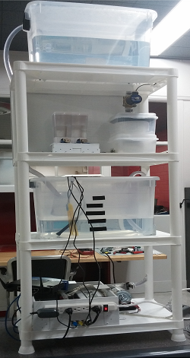
The Process

Slide 3
The Algorithm
Add Acid/Base Accordingly
Release Water
Start:
Check pH
Process Finished
Pump Up One Gallon
Determine
to add
Acid or Base
Calculate Difference

Slide 4
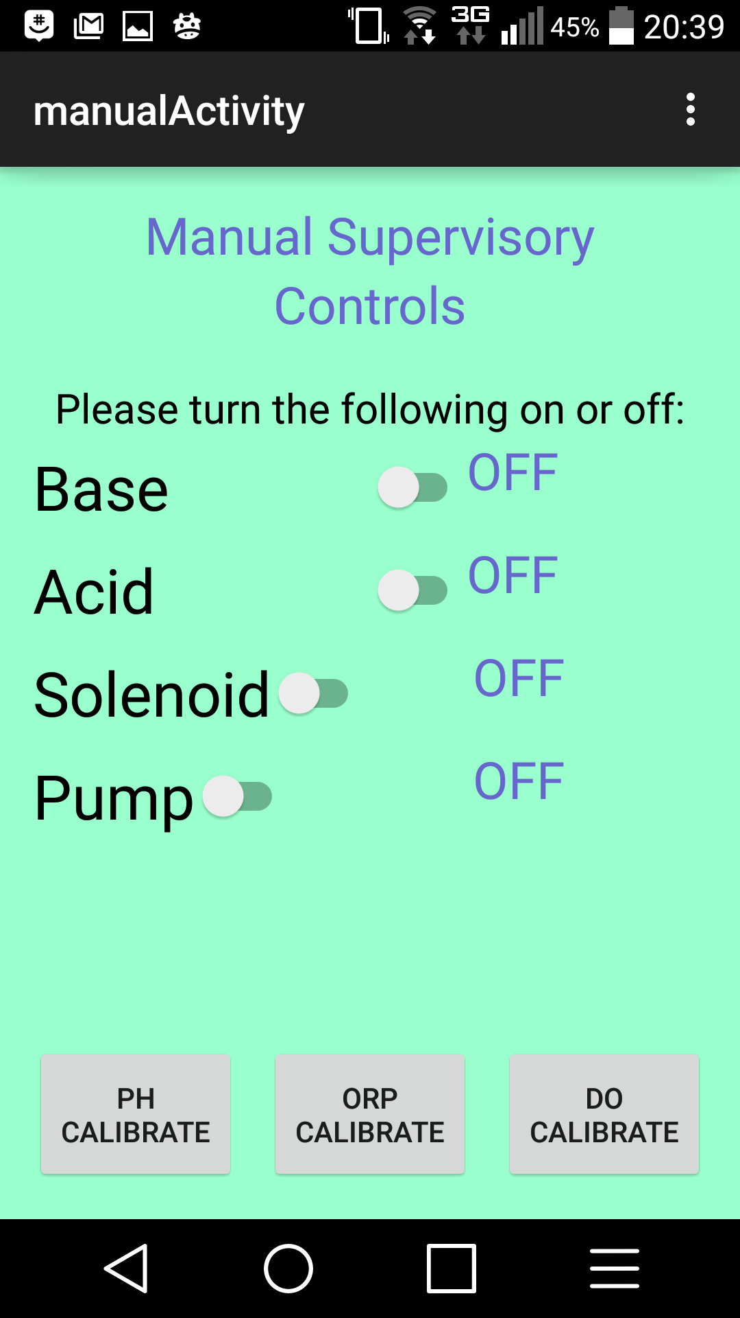
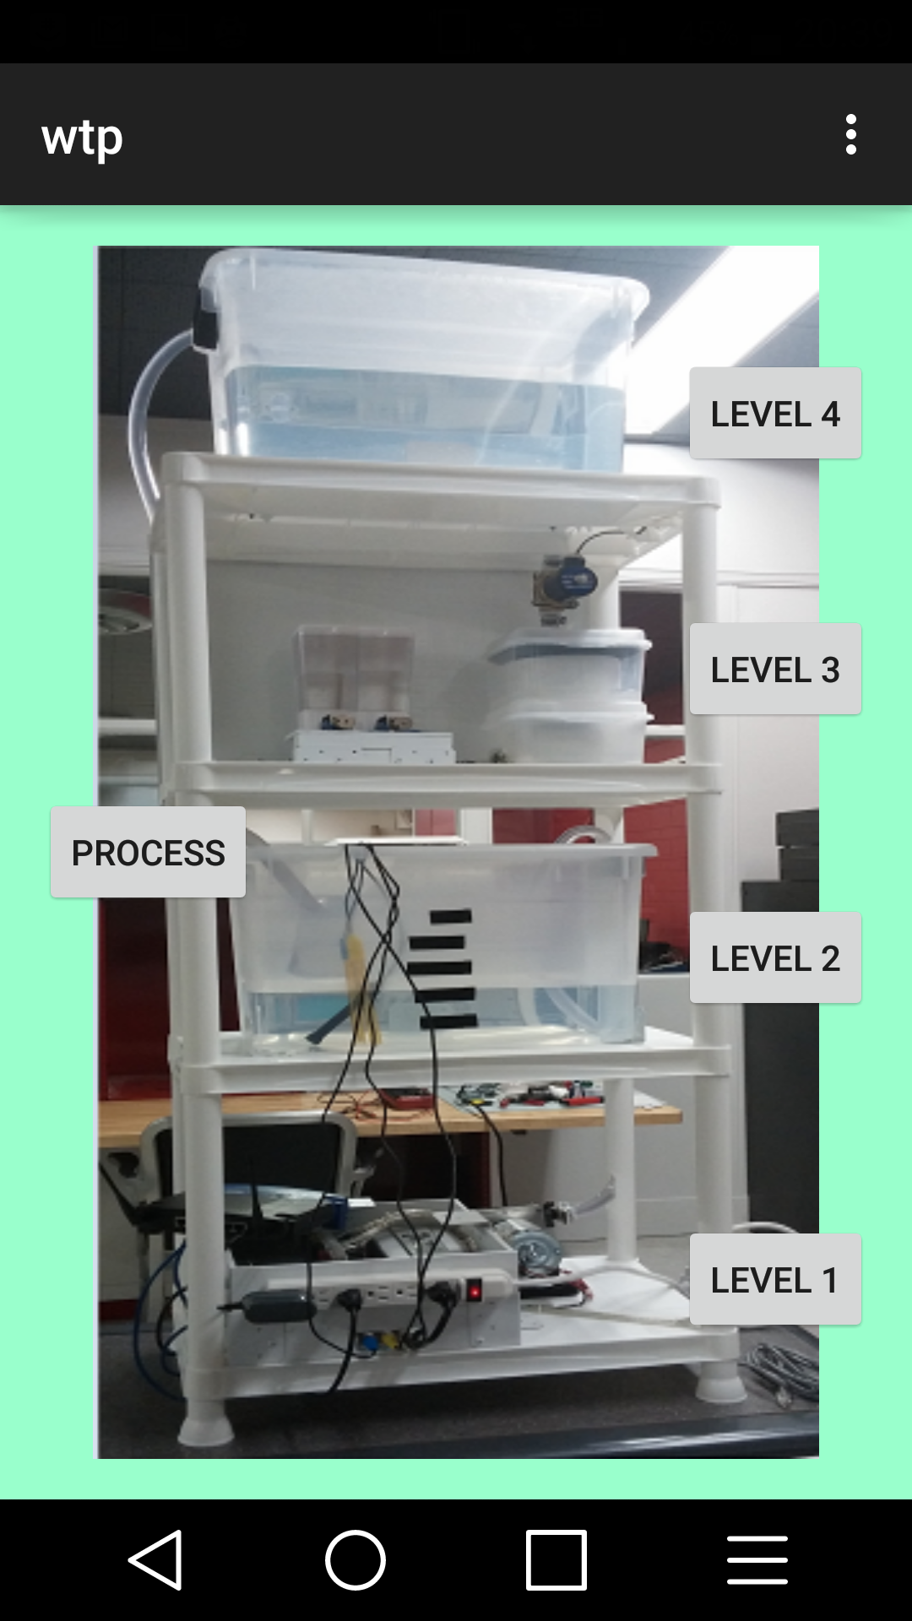
The Applications
Two Android Applications
Process Application
Teaching Application

Slide 5

Process Application
SCADA
Supervisory Controls
Data Acquisition

Slide 6
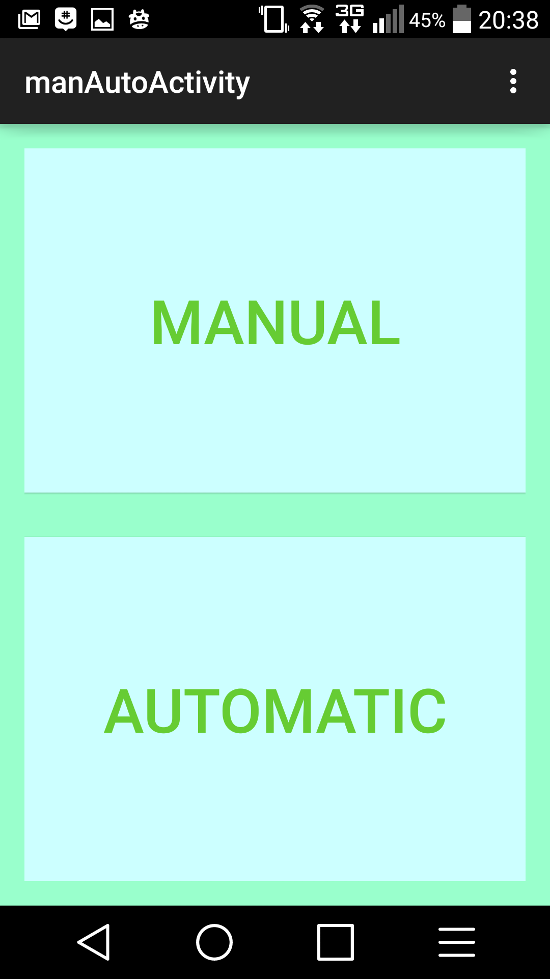
Supervisory Controls
Manual
Automatic

Slide 7
Manual Controls

Slide 8
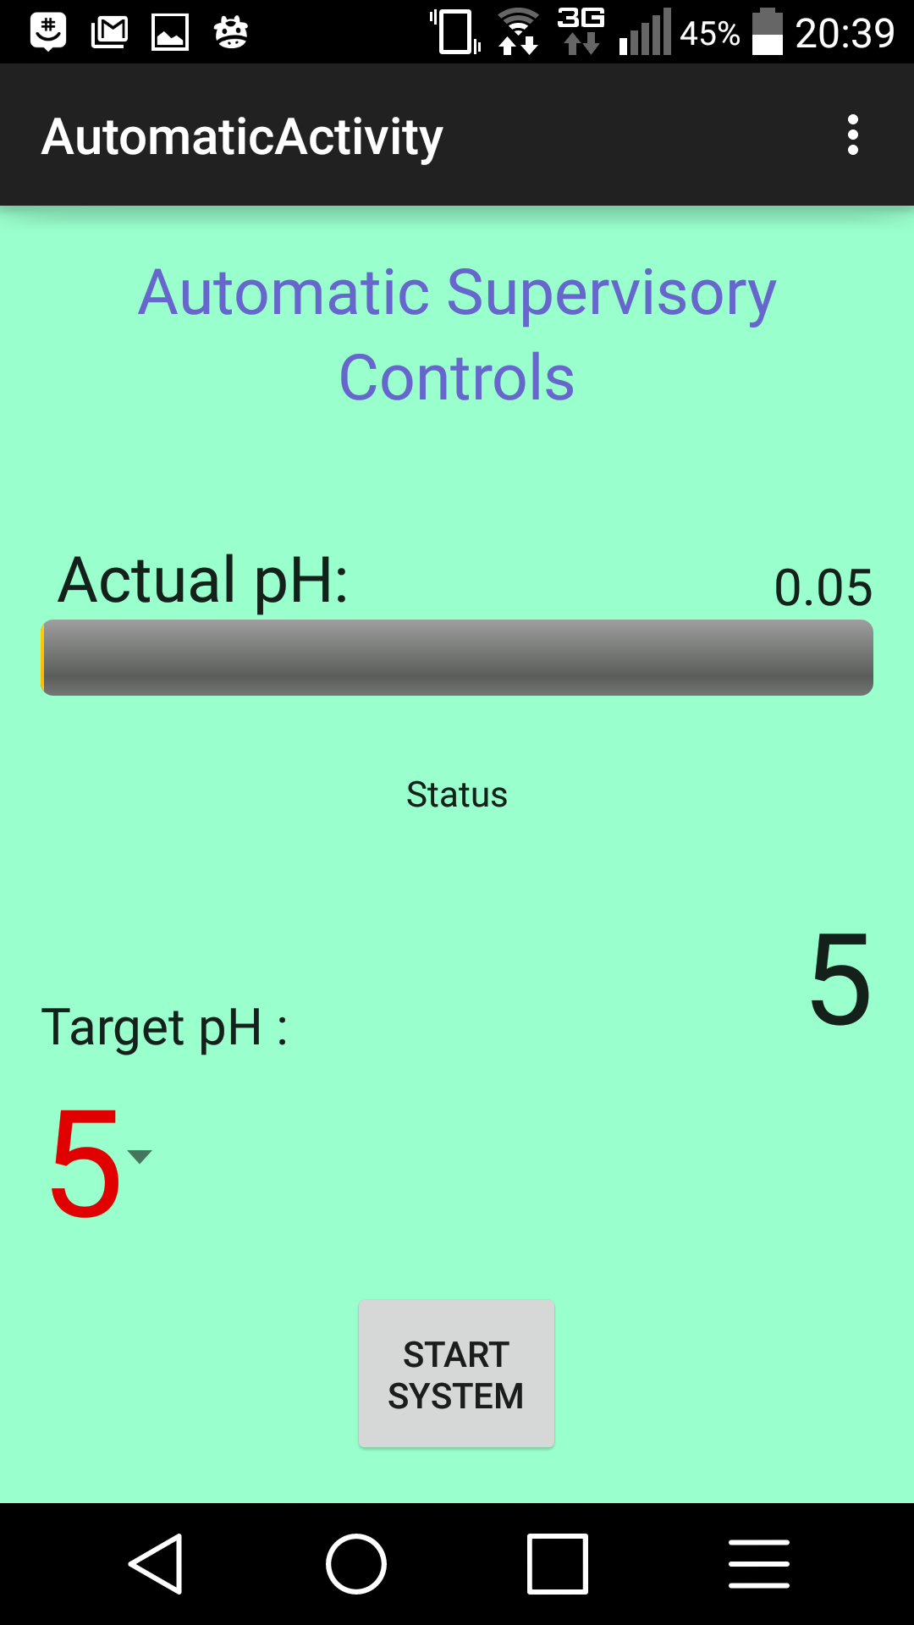
Automatic Controls

Slide 9
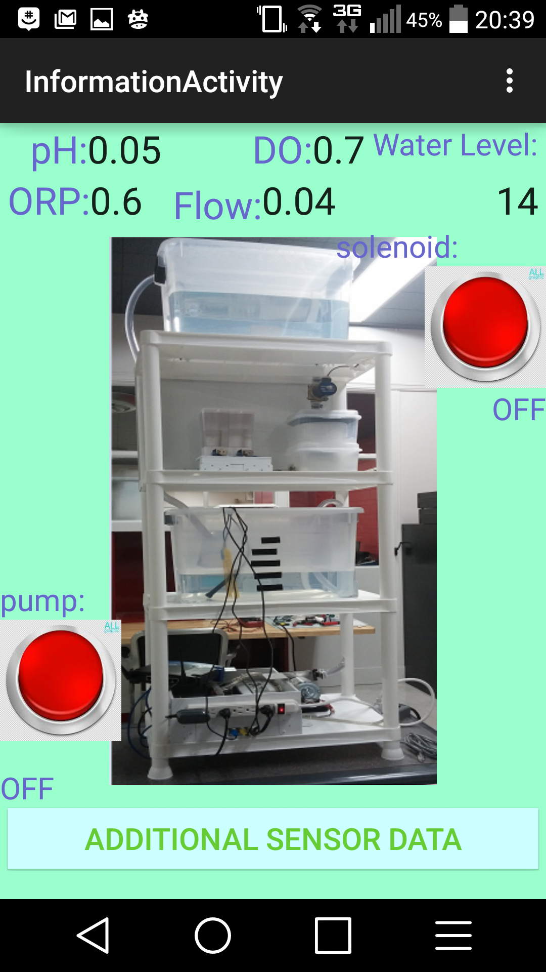
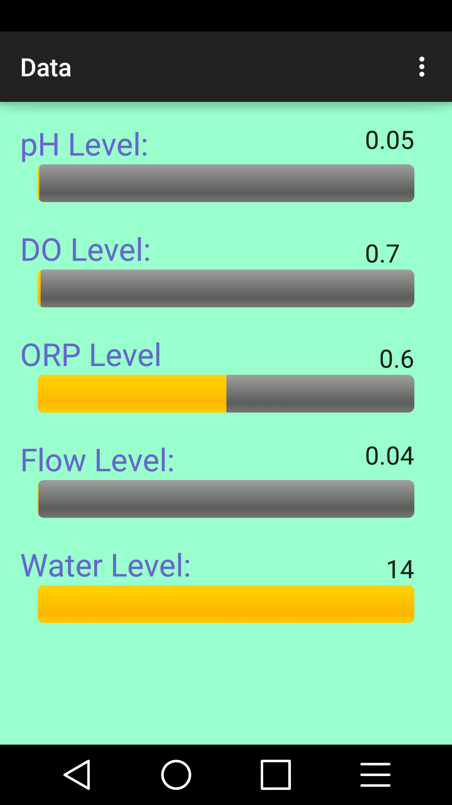
Data Acquisition

Slide 10
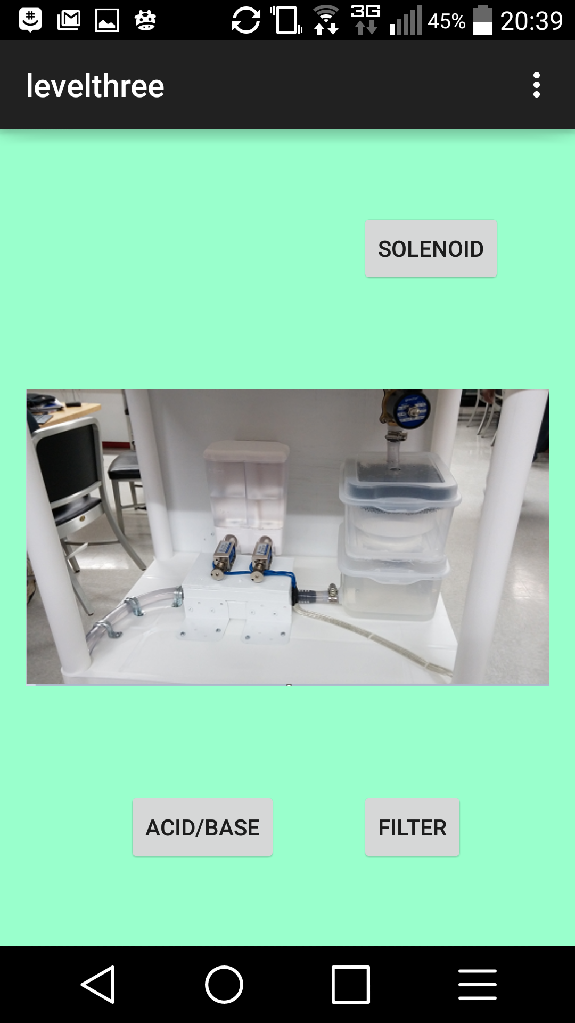
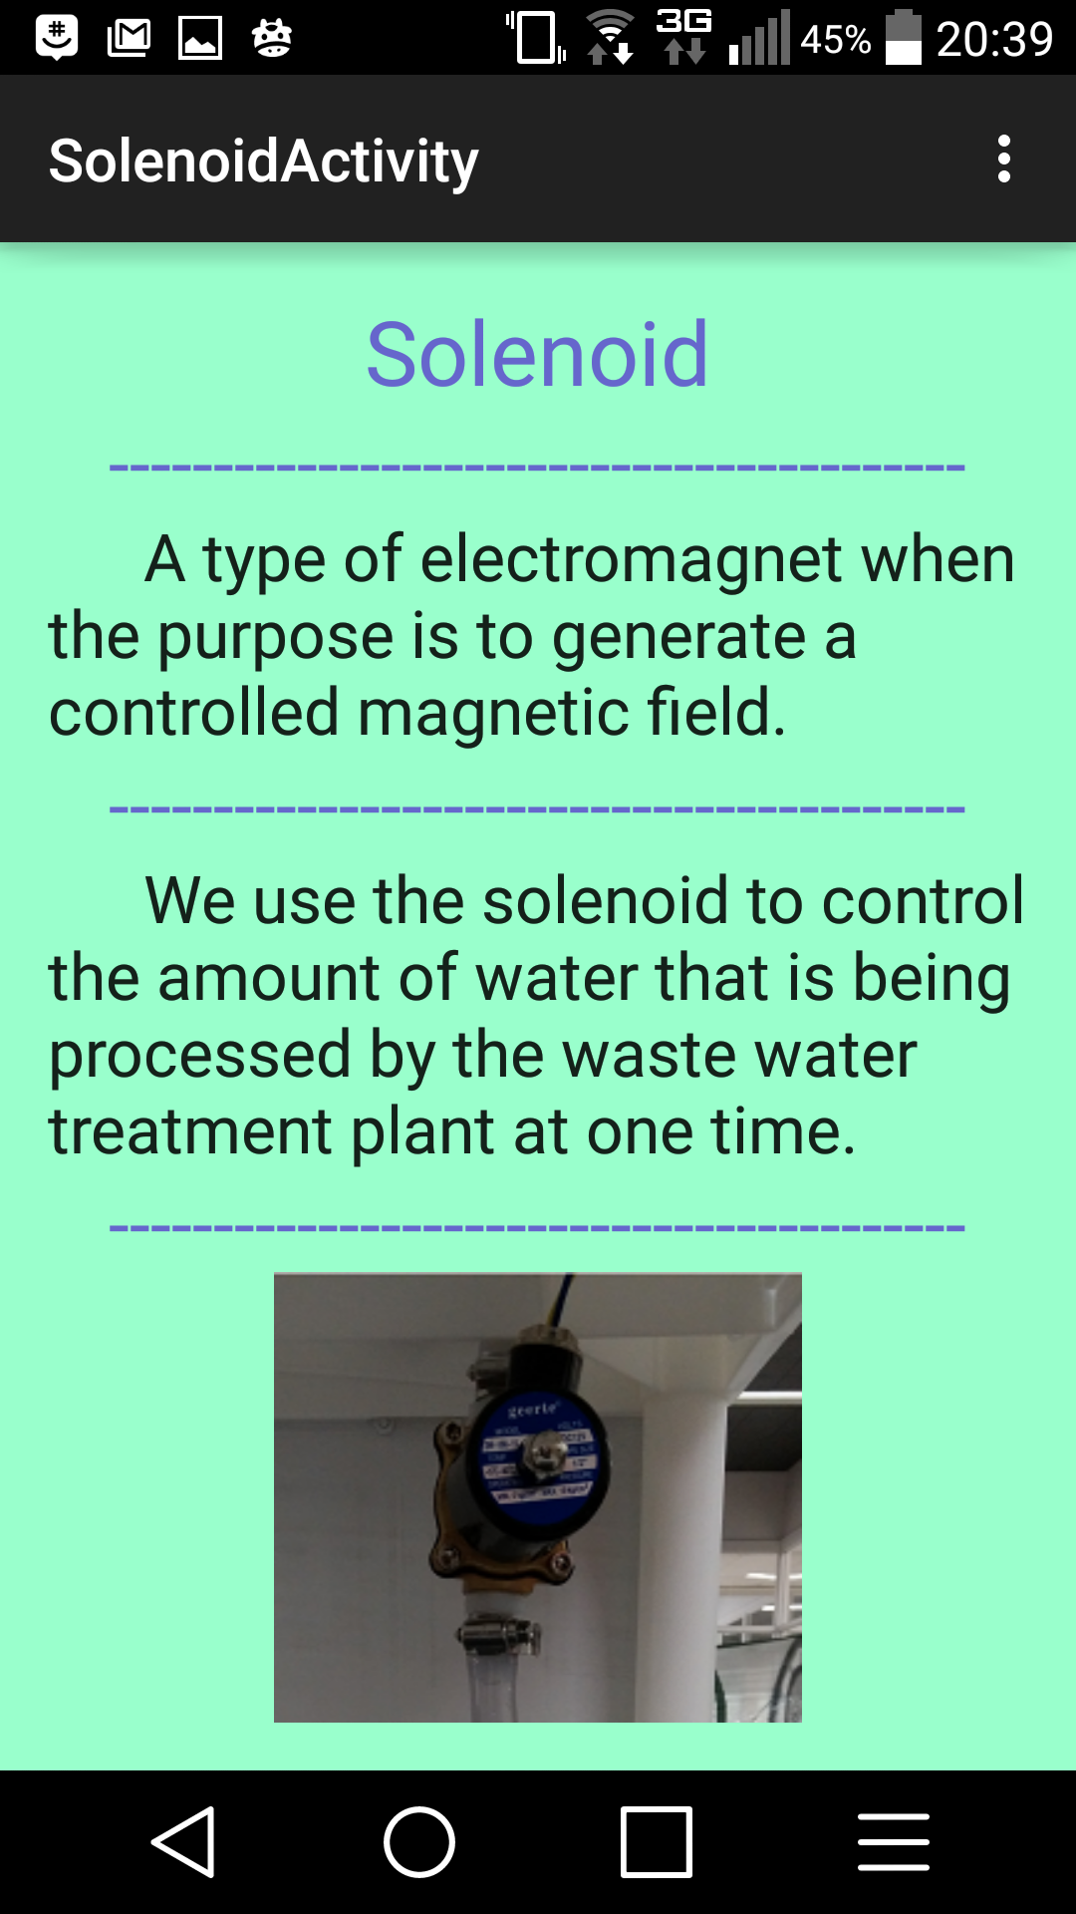
Teaching Application

Slide 11
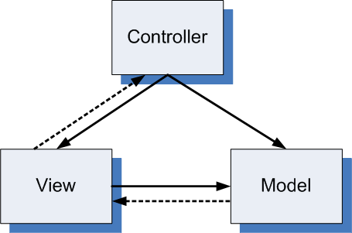
The Code
MVC Design
Model View Controller
Modbus Connection
Data Collection
Process Cycle & Control

Slide 12
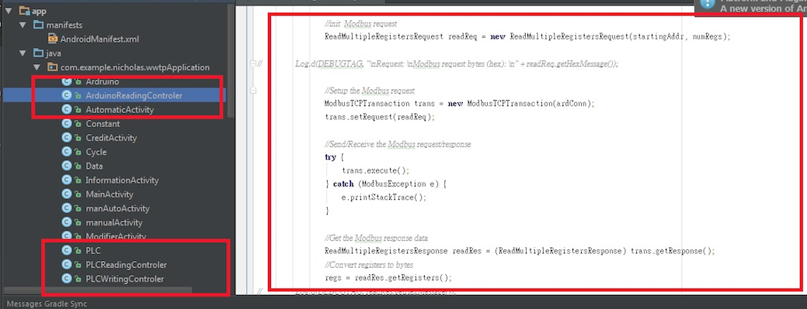
Modbus Connection
Three Threads
PLC Read
100ms
PLC Write
Upon request
Arduino Read
100ms Timer
Arduino Writing

Slide 13
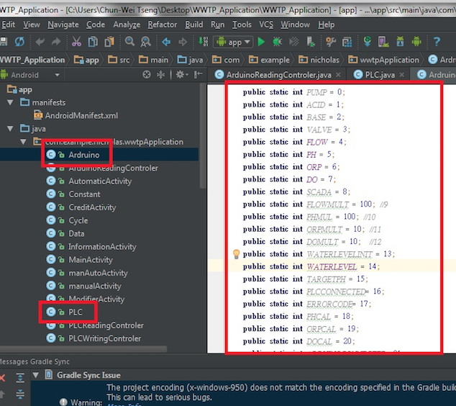
Data Collection
Singleton

Slide 14
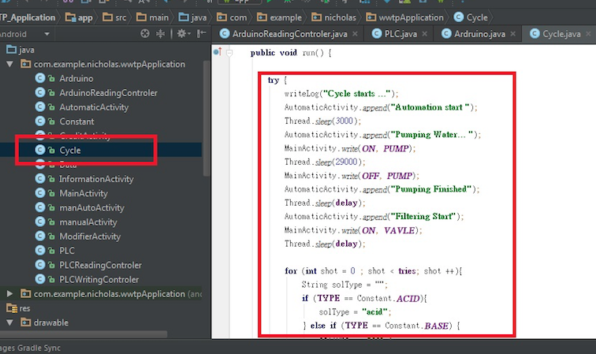
Process Cycle and Control
Sending Request for Address
User Inputs
Asleep/Delay Thread
Accuracy Check

Slide 15
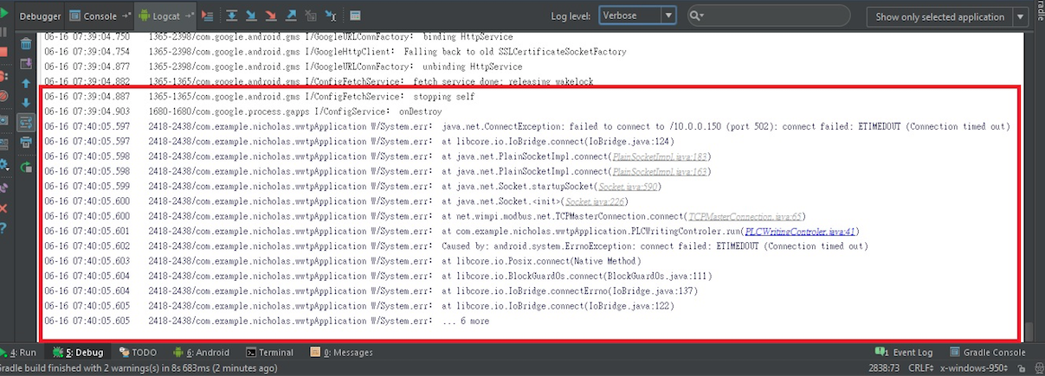
Modbus Challenges
Modbus Connection
TCP Connection
Socket Timeout Exception
Collection Limitation

Slide 16
Data Collection Challenges
Data Collection
Synchronize Data
Event Driven

Slide 17
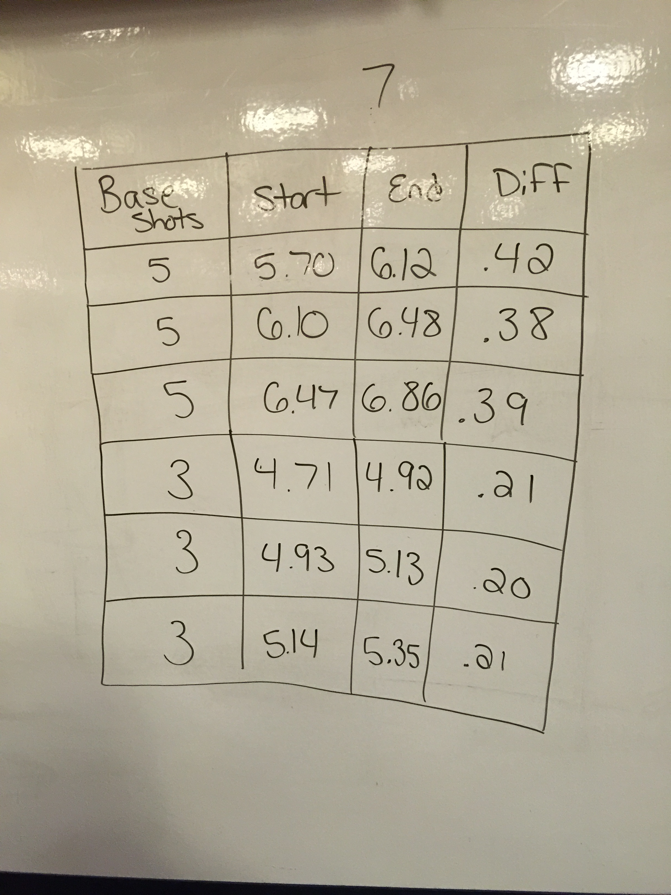
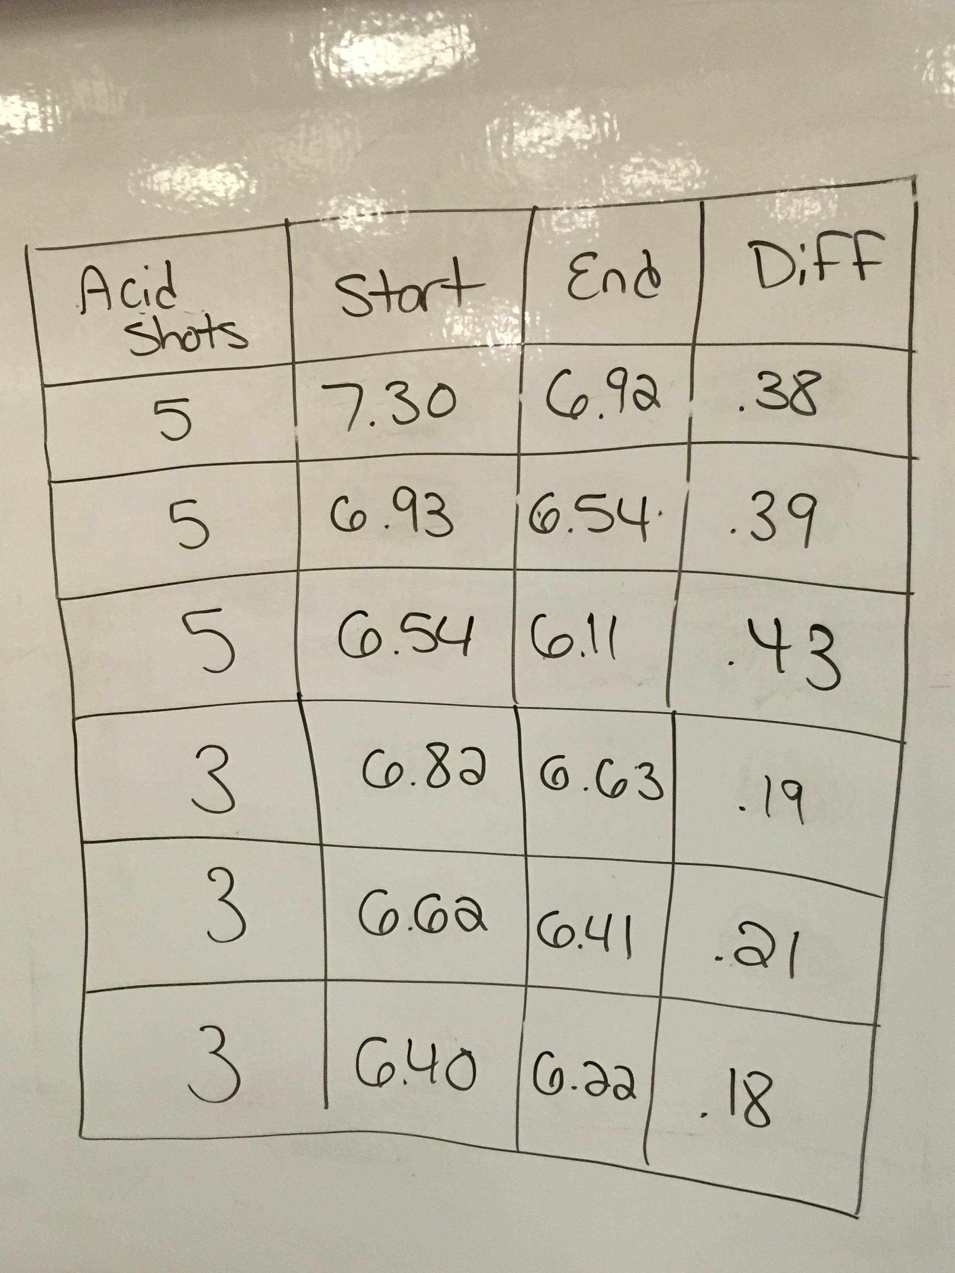
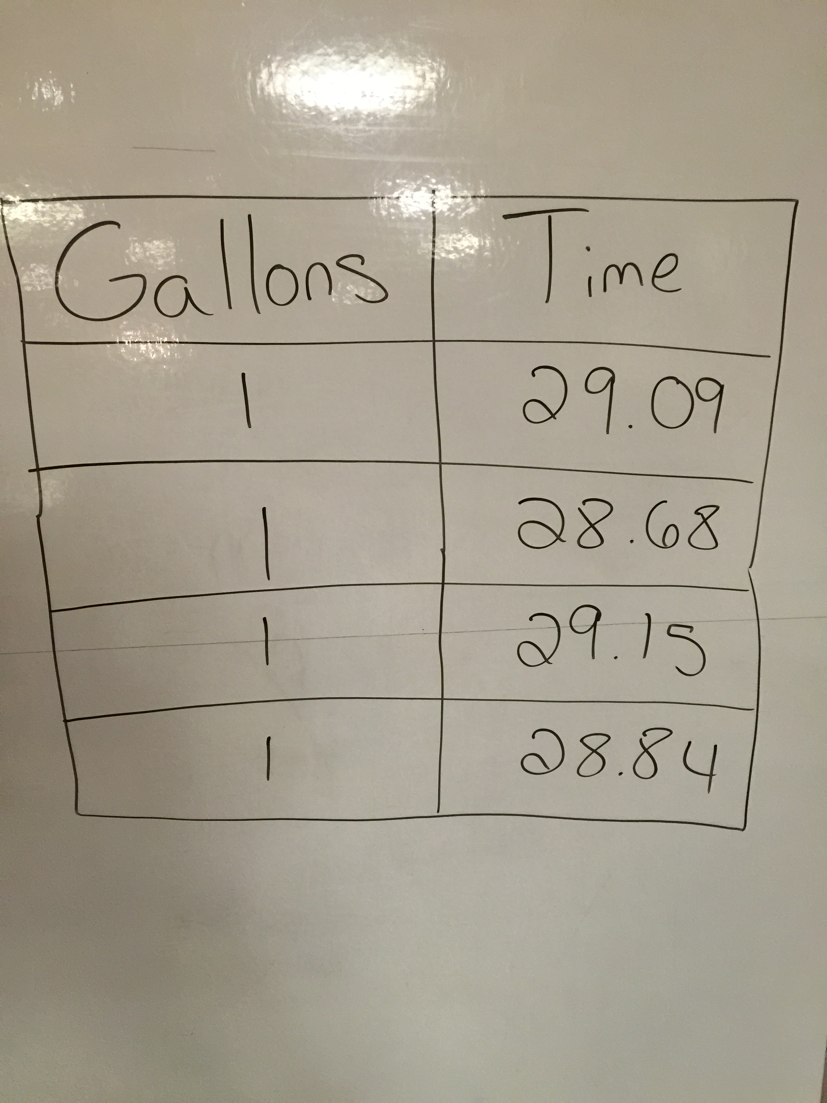
Process Cycle Challenges
Process Cycle & Control
Testing
Acid/Base Needed
Pump Time

